Slide 1
Trees
CSE 2213 – Discrete Mathematics
Course teacher: Minhajul Bashir

Slide 2
What is a tree?
A tree is a connected undirected graph with no simple circuits
Since there is no simple circuits, there cannot be multiple edges and loops
Thus, the graph must be a simple graph

Slide 3
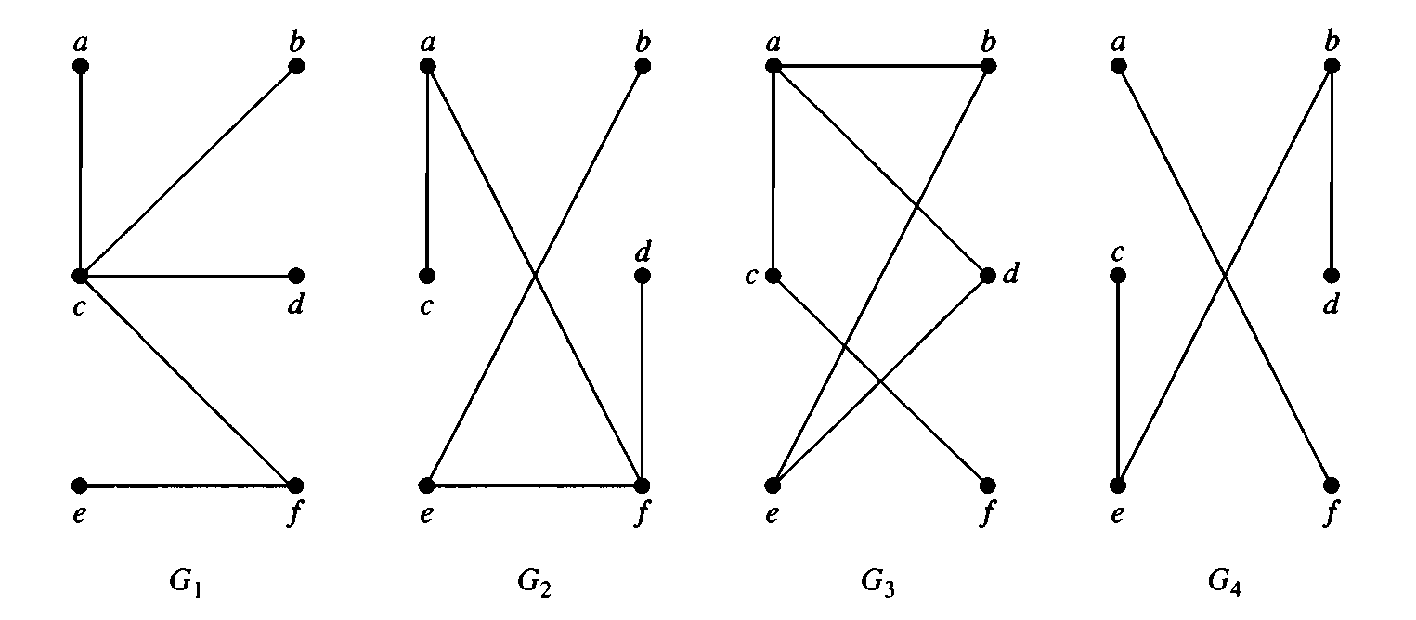

Which of the following are trees?

Slide 4






Rooted trees
$$c$$
$$a$$
$$b$$
$$f$$
$$d$$
$$e$$

Slide 5
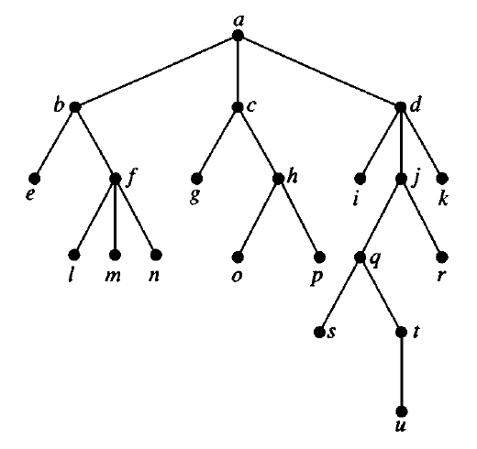
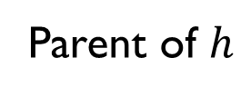
Some terminologies
Parent of $h$

Slide 6

Some terminologies
Children of $j$

Slide 7
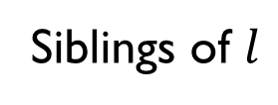
Some terminologies
Siblings of $l$

Slide 8
Some terminologies
Root of the tree

Slide 9
Some terminologies
Internal vertices

Slide 10
Some terminologies
Leaves

Slide 11
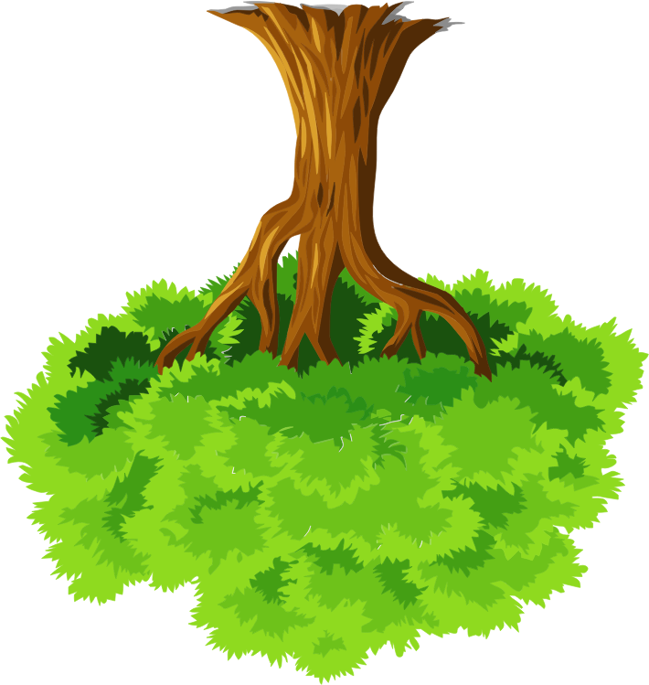






Rooted trees
$$c$$
Root
$$a$$
$$b$$
$$f$$
$$d$$
$$e$$
Leaves

Slide 12
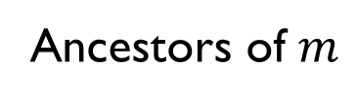
Some terminologies
Ancestors of $m$

Slide 13
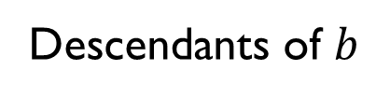
Some terminologies
Descendants of $b$

Slide 14
Properties of trees

Slide 15
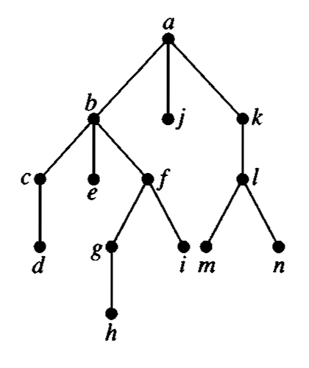
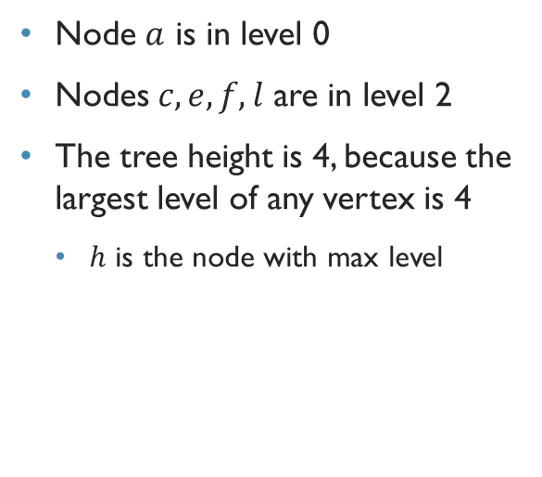
Height of tree and level of nodes
Node $a$ is in level 0
Nodes $c,e,f,l$ are in level 2
The tree height is 4, because the largest level of any vertex is 4
$h$ is the node with max level

Slide 16
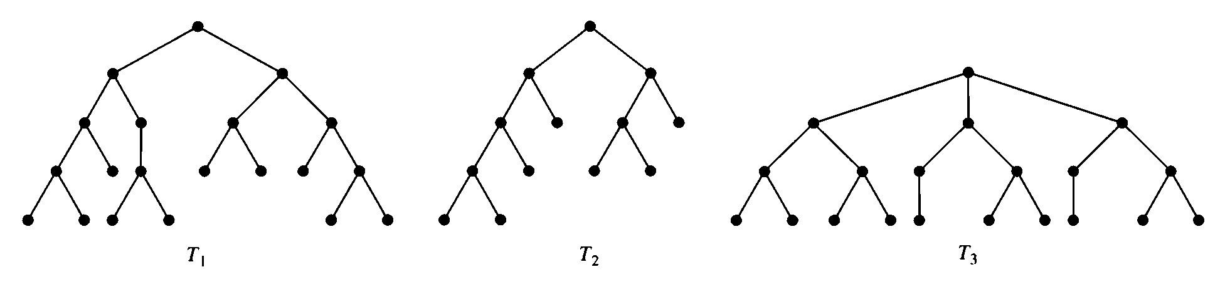
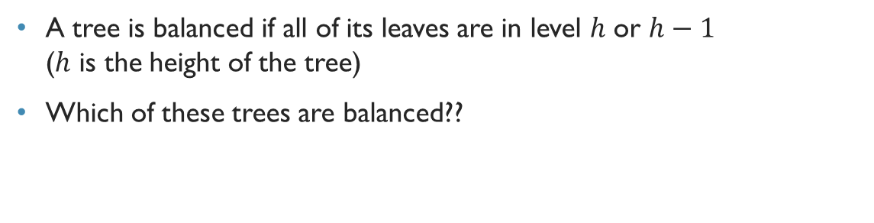
Balanced tree
A tree is balanced if all of its leaves are in level $h$ or $h−1$ ($h$ is the height of the tree)
Which of these trees are balanced??

Slide 17
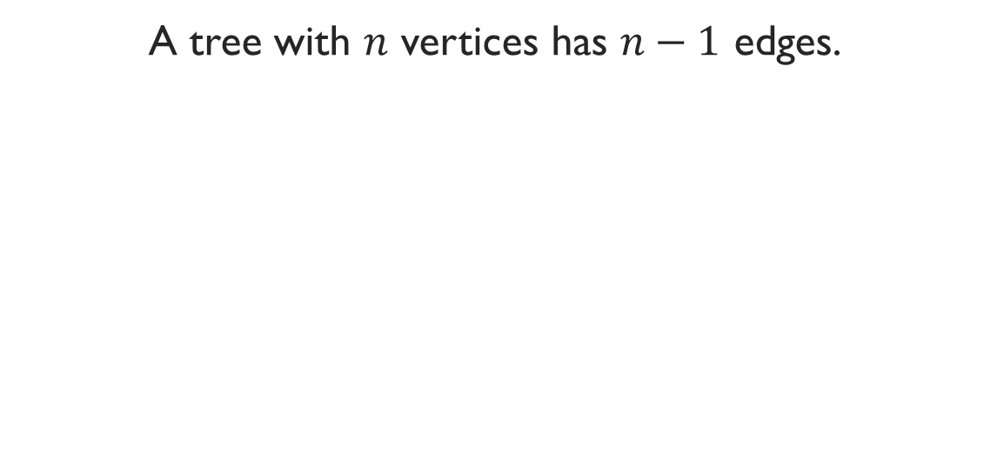
Theorem 2
A tree with $n$ vertices has $n−1$ edges.

Slide 18
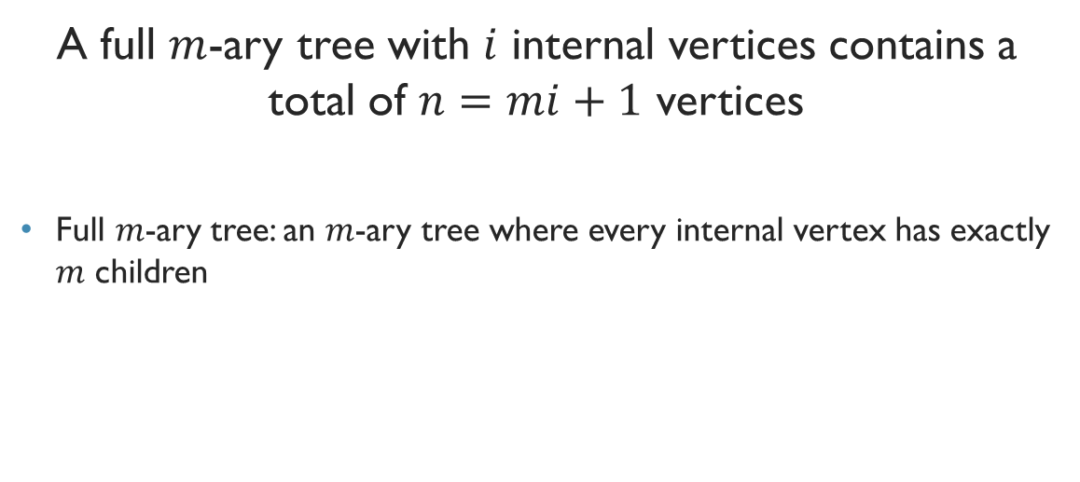
Theorem 3
A full $m$-ary tree with $i$ internal vertices contains a total of $n=mi+1$ vertices
Full $m$-ary tree: an $m$-ary tree where every internal vertex has exactly $m$ children

Slide 19
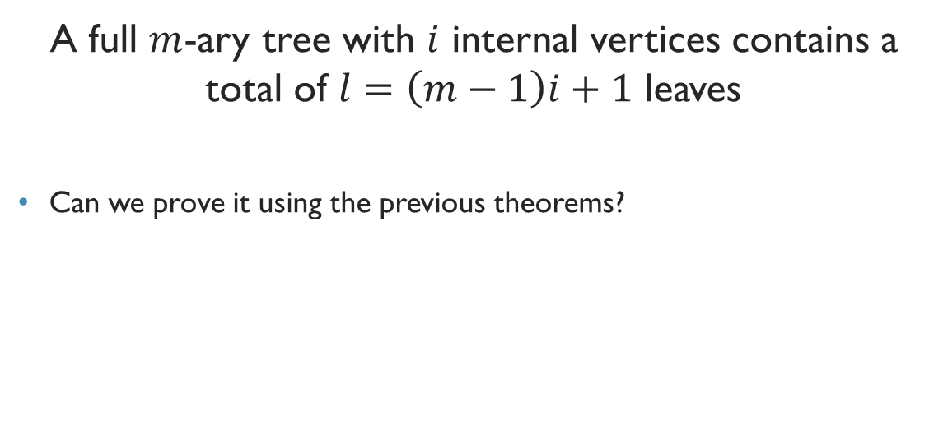
Theorem 4
A full $m$-ary tree with $i$ internal vertices contains a total of $l=\left(m−1\right)i+1$ leaves
Can we prove it using the previous theorems?

Slide 20

But theorem 4 has three parts in the textbook!!!
Theorem 4 gives us formulae to find out every possible parameters of a full $m$-ary tree
We can deduce the other relations using theorem 3 and 4 from this slide only, no other things required.
As a matter of fact, only theorem 3 suffices!!!

Slide 21
Example
Calculate the number of vertices in a full 5-ary tree with 45 internal vertices.
Also, find out the number of leaves.

Slide 22
Example
Calculate the number of internal vertices in a full 5-ary tree with 45 leaves.
Also, find out the total number of vertices.

Slide 23
Exercise
Calculate the number of vertices in a full 5-ary tree with 35 internal vertices.
Also, find out the number of leaves.
*******
Calculate the number of internal vertices in a full 5-ary tree with 35 leaves.
Also, find out the total number of vertices.

Slide 24
Have you ever spread messages like this?
6 May 2018 রাত 9:00 PM থেকে রাত 10:00 PM এই এক ঘন্টা সময়ের মধ্যে বাংলাদেশের সকল Android ফোনে Blue whale গেম ঢুকিয়ে দেওয়া হবে। যা প্রবেশের ফলে আপনার ফোনের সকল Parsonal information, Facebook, Twitter, imo,whatsapp সহ সকল কিছু ধ্বংস করতে সক্ষম তাই আগামিকাল রাত 9:00 PM থেকে 10:00 PM পর্যন্ত আপনার ফোন বন্ধ রাখুন। আর দেশের সেবায় আপনার দশজন বন্ধুর কাছে এই মেসেজটি ফরোয়ার্ড করুণ। জনসচেতনতায়: BTRC

Slide 25
exercise
Someone started spreading the hoax message and sent it to 10 people
Some people responded to this and each of them forwarded it to ten people
100 people among those who had seen the post did not believe this and did nothing
How many people have seen this message (including the hoax-creator) if no one receives more than one such message?

Slide 26
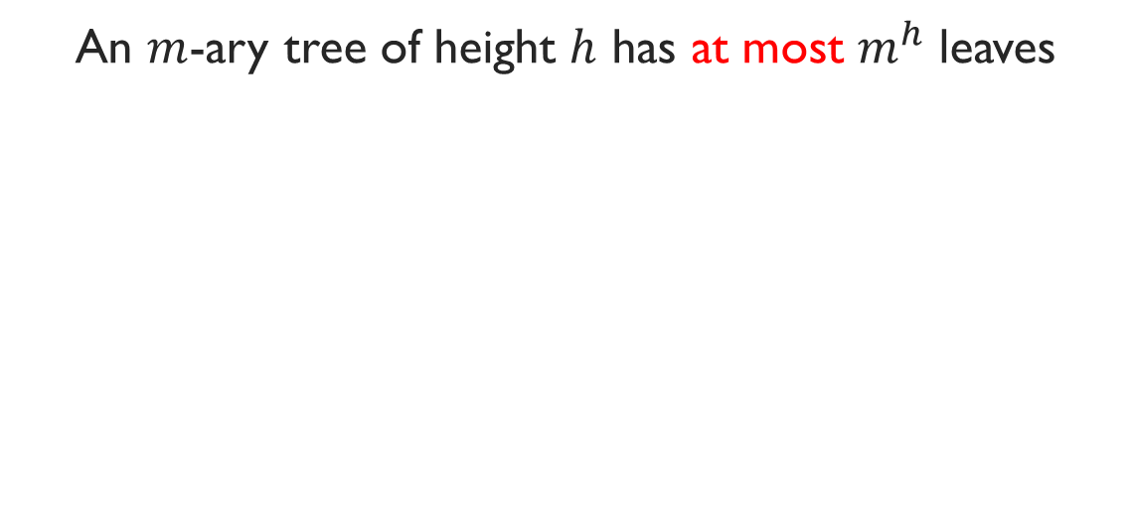
Theorem 4
An $m$-ary tree of height $h$ has at most $m^{h}$ leaves

